Slide 1
HYDROGEN

Slide 2
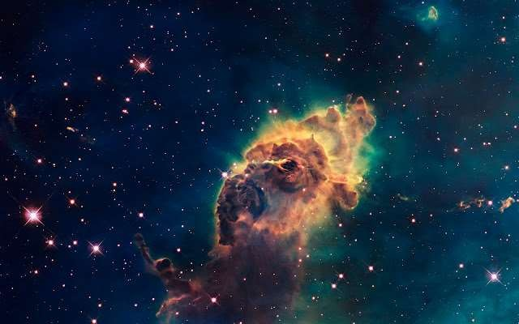
*Lightest element known having atomic number 1.
* Dihydrogen
Position of Hydrogen in Periodic Table
*It resembles both alkali metals and halogens and therefore, its position is anomalous.
* In modern periodic table it is located separately

Slide 3
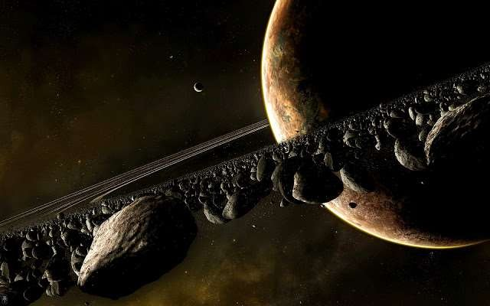
Resemblance with alkali metals:-
Electronic configuration 1H = 1s1
11Na = 1s2, 2s2, 2p6, 3s1
19K = 1s2, 2s2, 2p6, 3s23p6, 4s1
Electropositive character: H+, Na+, K+ etc.
Oxidation state: +1
Combination with electronegative elements: form binary compounds with electronegative elements like alkali metals.
Halides: HClNaCl, KCletc Sulphides: H2S Na2S, K2S etc

Slide 4

Resemblance with halogens:-
1. Electronic configuration:
Both contain one electron less than the 1H = 1s1 (near to 2He)
9F = 1s2, 2s2, 2p5 (near to 8Ne)
17K = 1s2, 2s2, 2p6, 3s23p5 (near to 18Ar)
noble gas configuration
Non-metallic character: like halogens, hydrogen is non-metallic in nature.
Atomicity: Diatomic molecules.
Formation of similar types of compounds:
Halides: CCl4, SiCl4, GeCl4
Hydrides: CH4, SiH4, GeH4
5. Oxidation state: –1 Na+1H-1 Na+1Cl-1

Slide 5
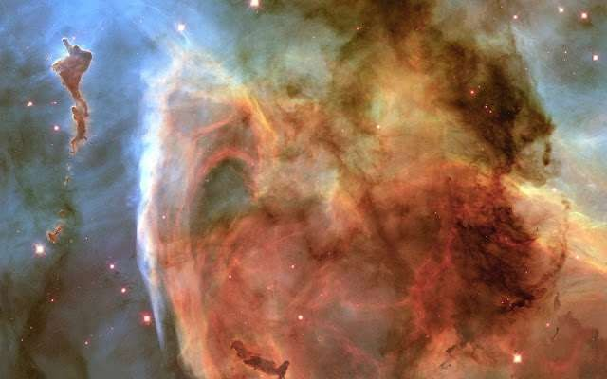
Difference from alkali metals:-
Ionization enthalpy: - the ionization enthalpy of hydrogen is very high in comparison to alkali metals.
Non- metallic character: alkali metals are typical metals while hydrogen is
non-metal
Atomicity: hydrogen is diatomic while alkali metals are monoatomic.
Nature of compounds: the compounds of hydrogen are predominantly covalent while those of alkali metals are ionic. For example: HCl is covalent
while NaCl is ionic.
The oxides of alkali metals are basic while hydrogen oxide is neutral.

Slide 6
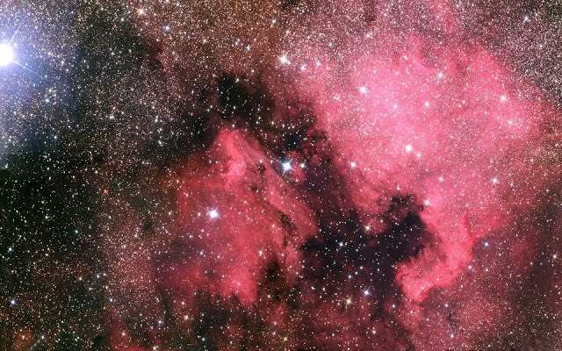
Difference from halogens:-
Less tendency for hydride formation:Hydrogen has less tendency to take up
electron to form hydride ion (H-) as compared to the halogens which from halide ions (X-) very easily.
Absence of unshared pairs of electrons :
Nature of oxides: The oxides of halogens are acidic while hydrogen oxide is neutral.
Occurrence of Hydrogen:
* Hydrogen, the most abundant element in the universe and the
third most abundant on the surface of the globe, is being visualised as the major future source of energy

Slide 7
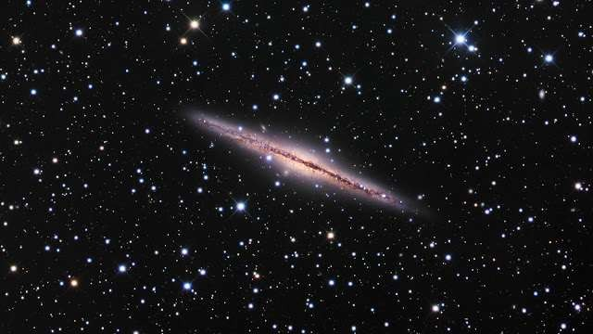

Preparation:
Methods for commercial production of dihydrogen
1. Electrolysis of water 2H2O(l) 2H2(g) O2(g)
The hydrogen prepared by this method is of very high purity. However, this
method is not commonly used because it is very expensive. This method is can be used only at those places where the electricity is cheap.
By the reaction of steam on coke :- C + H2O(g) CO + H2
Water gas
Since the mixture of CO and H2 is used for the synthesis of methanol and a number of hydrocarbons, it is also called synthesis gas or syn gas.
The process of producing syn gas from coal or coke is called coal gasification. CO + H2 + H2O → CO2 + 2H2
Water gas steam
This reaction is called water gas shift reaction.

Slide 8
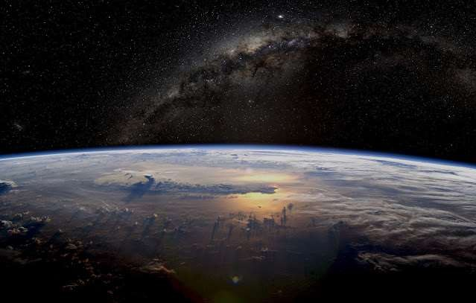
Properties of Hydrogen:-
* Physical Properties:-
It is slightly soluble in water (about 2 %)
It is highly combustible and therefore should be handled carefully.
It lightest substance. The weight of one litre hydrogen at NTP is only 0.0899 g.
* Chemical properties:-Not very reactive due to high bond dissociation energy
(435.88 kJ mol-1 at 298.2 K)
Combustion: - It burns with pale blue flame 2H2 (g) + O2 (g) 2H2O(l)
Reaction with metals:-Reactive metals like Na, K, Ca, Li and form hydrides. Ca + H2CaH2
* Metals like Pt, Pd, Ni (elements of d block) form interstitial hydrides by absorbing large volume of hydrogen. Such hydrogen is called ‘occluded hydrogen and this property of adsorption of a gas by a metal is called occlusion.
(iii) Reaction with metal oxides:-Hydrogen reduces oxides of less active metals to corresponding metal.

Slide 9
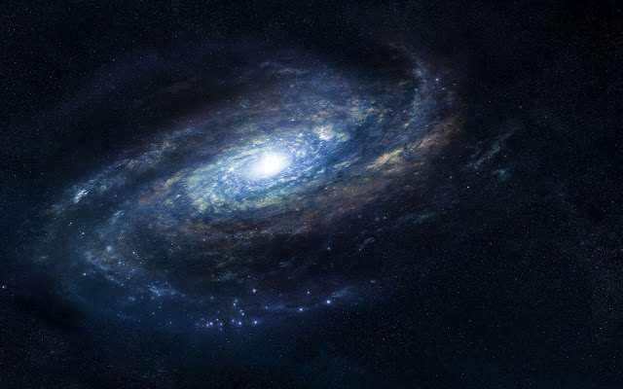
Vegetable oils are polyunsaturated in nature. The C=C bonds in oils can easily undergo oxidation and the oil becomes rancid i.e., unpleasant in taste. Hydrogenation reduces the number of double bonds but completely.
Hydrogenation of oils:-
Uses of Hydrogen:-
as a reducing agent.
In the manufacture of vanaspati fat, ammonia, metal hydrides, methanol, fertilizers such as urea etc.
In the manufacture of synthetic petrol.
In the atomic hydrogen torch and oxy hydrogen torches for cutting and welding.
Dihydrogen is dissociated with the help of an electric arc and the hydrogen atoms produced are allowed to recombine on the surface to be welded. High temperature of about 4000 k is generated.
In the fuel cell for generating electrical energy.

Slide 10
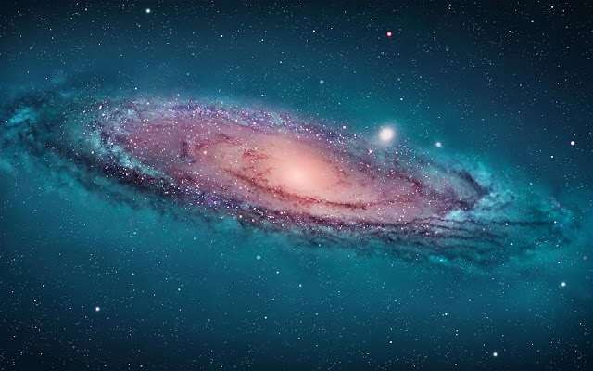
Hydrides:-
Under certain conditions H2 combines with almost all the elements ,except noble gasesto form compounds called hydrides.
* There are three types of hydrides ,they are
Ionic or saline hydrides
Covalent or molecular hydrides (iii) Metallic or non-stoichiometric hydrides(i)
Ionic or saline hydrides:-
* These are the compounds of H2 formed with most of the s-block elements which are highly electro positive.
(ii) Covalent or molecular hydrides:-These are the compounds of hydrogen
formed with most of the p-block elements
* Electron deficient:- The hydrides which do not have sufficient number of electrons to form normal covalent bonds is called electron deficient hydride. For example, hydride of group 13 (BH3, AlH3, etc.).They are known as Lewis acids i.e., electron acceptors. To make up their deficiency they generally exist in polymeric forms such as B2H6, Al2H6, etc.

Slide 11
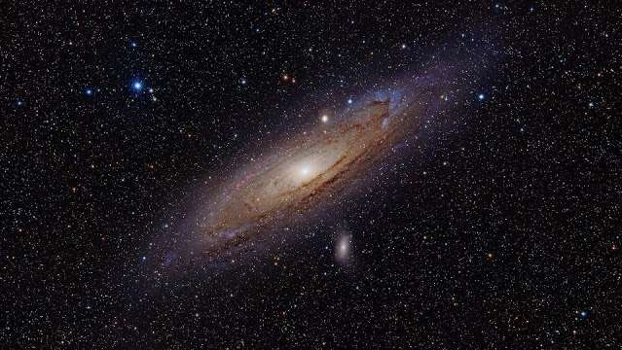
* Electron precise:-
The hydrides which have sufficient number of electrons
required for forming covalent bonds is called electron precise hydride. For example, hydrides of group 14 (CH4, SiH4, GeH4, SnH4, PbH4 etc.) they have
tetrahedral geometry.
* Electron rich hydrides:-
The hydrides which have excess electrons as required
to form normal covalent bonds is called electron rich hydride. For example, hydrides of group 15 to 17 (NH3, PH3, H2O, H2S, H2Se, H2Te, HF etc.)
# Metallic or non-stoichiometric hydrides:-
These are formed by many d-block and f-block elements
These hydrides conducts heat and electricity though not efficient.

Slide 12
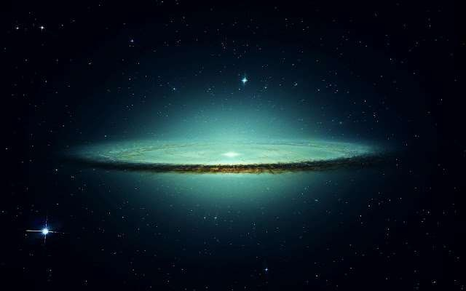
Water: -
Water! It is the major part of all living organisms.water is also known as the river of life.
Human body has about 65%and some plants haveasmuch as 95%water.
STRUCTURE OF WATER:-
In a gas phase water is bent molecule with a bond angle of 104.5 and O-H
bond length of 95.7pm It is highly polar molecule.
Structure of ice:-
Ice has a highly ordered 3D
hydrogen bonded structure. Each oxygen atom is surrounded tetrahedrally by four other four other oxygen atoms at a distance of 276 pm

Slide 13
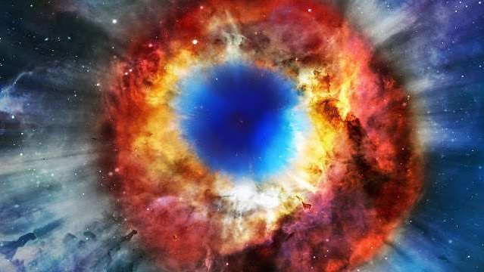
Chemical Properties of water:-
AMPHOTERIC NATURE:-
It has the ability to act as an acid as well as base
.it acts as an acid with NH3 and as a base with H2S
H2O(l) +NH3(aq)→OH-(aq) +NH4 + (aq) H2O(l) +H2S(aq) →H3O+(aq) +HS- (aq)
REDOX REACTIONS INVOLVING WATER:-
* Water can be easily reduced to H2 by highly electropositive metals
2H2O(l) +2Na(s) →2NaOH(aq) +H2(g)
HYDROLYSIS REACTION:-
*Due to high dielectric constant, it has a very
strong hydrating tendency .it dissolves many ionic compounds P4O10(s) +6H20(l) →4H3PO4(aq)
SiCl4(l) +2H2O(l) →SiO2(s) + 4HCl(aq)

Slide 14
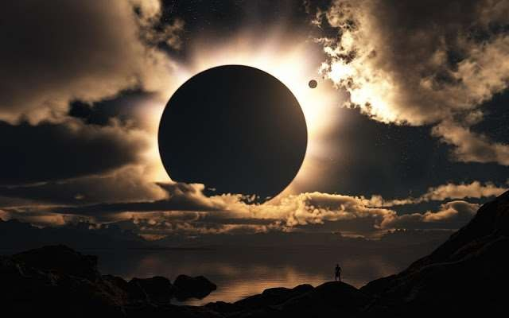
HYDRATES FORMATION:-
From the aqueous solutions many salts can be
crystallized as hydrated salts. It of different types.
Coordinated water e.g., [Cr(H2O)6]3+ 3Cl-
Interstitial water e.g.,BaCl2.2H2O
hydrogen-bonded water e.g. [Cu(H2O)4]2+ 4SO2- .H2Oin CuSO4.5H2O

Slide 15



